Slide 1
Lecture 3 – Security Governance
COM744: Security and Risk Management
Nigel Houlden / Jason Davies
n.houlden@glyndwr.ac.uk / Jason.Davies@glyndwr.ac.uk

Slide 2
Security management concepts and principles are inherent elements in a security policy and solution deployment.
They define the basic parameters needed for a secure environment.
They also define the goals and objectives that both policy designers and system implementers must achieve to create a secure solution.

Slide 3
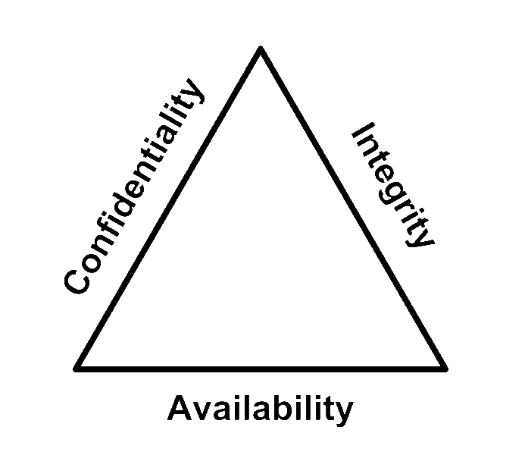
C-I-A Triad
Confidentiality
Integrity
Availability

Slide 4
The primary goals and objectives of security are contained within the CIA Triad

Slide 5
Confidentiality
If a security mechanism offers confidentiality, it offers a high level of assurance that data, objects, or resources are restricted from unauthorized subjects.
If a threat exists against confidentiality, unauthorized disclosure could take place.
In general, for confidentiality to be maintained on a network, data must be protected from unauthorized access, use, or disclosure while in storage, in process, and in transit.

Slide 6
Confidentiality
Numerous attacks focus on the violation of confidentiality.
These include:
capturing network traffic
stealing password files
social engineering,
port scanning,
Shoulder surfing,
eavesdropping,
sniffing, and many others.

Slide 7
Confidentiality
Many instances of unauthorized disclosure of sensitive or confidential information are the result of human error, oversight, or ineptitude.
Events that lead to confidentiality breaches include:
failing to properly encrypt a transmission,
failing to fully authenticate a remote system before transferring data,
leaving open otherwise secured access points,
accessing malicious code that opens a back door,
documents left on printers,
not ‘locking’ a screen when unattended.

Slide 8
Confidentiality
Violations can also occur because of an oversight in a security policy or a misconfigured security control.
Confidentiality and integrity depend on each other.
Without object integrity, confidentiality cannot be maintained.

Slide 9
Integrity
Integrity can be examined from three perspectives:
Preventing unauthorized subjects from making modifications
Preventing authorized subjects from making unauthorized modifications, such as mistakes
Maintaining the internal and external consistency of objects so that their data is a correct and true reflection of the real world and any relationship with any child, peer, or parent object is valid, consistent, and verifiable

Slide 10
Integrity
For integrity to be maintained on a system, controls must be in place to restrict access to data, objects, and resources.
Additionally, activity logging should be employed to ensure that only authorized users are able to access their respective resources.
Maintaining and validating object integrity across storage, transport, and processing requires numerous variations of controls and oversight.

Slide 11
Integrity
Numerous attacks focus on the violation of integrity. These include:
viruses,
logic bombs,
unauthorized access,
errors in coding and applications,
malicious modification,
intentional replacement,
system back doors.

Slide 12
Accountability
An organisation’s security policy can be properly enforced only if accountability is maintained.
Effective accountability relies on the capability to prove a subject’s identity and track their activities.
It is established by linking a person to the activities of an online identity through the security services and the mechanisms of:
auditing,
authorization,
authentication,
and identification.

Slide 13
Accountability
Holding someone to accountability is ultimately dependent on the strength of the authentication process.
Without a strong authentication process, there is doubt that the human associated with a specific user account was the actual entity controlling that user account when the undesired action took place.

Slide 14
The point of security is to keep bad things from happening while supporting the occurrence of good things.
When bad things do happen, organisations often desire assistance from law enforcement and the legal system.
Conversely you may also need to state all reasonable steps were taken to defend your organisation.
As the legal system may be coming after you!!

Slide 15
Nonrepudiation
Nonrepudiation ensures that the subject of an activity or event cannot deny that the event occurred.
prevents a subject from claiming not to have sent a message, not to have performed an action, or not to have been the cause of an event.
made possible through identification, authentication, authorization, accountability, and auditing.
Nonrepudiation can be established using digital certificates, session identifiers, transaction logs, and numerous other transactional and access control mechanisms.

Slide 16
Nonrepudiation
Nonrepudiation is essential for accountability.
If someone can repudiate your evidence then they can not be held accountable.

Slide 17
I tell you I didn't do it
'Cause I wasn't there
Don't blame me, it just isn't fair
You listen to their side
Now listen to mine
Can't think of a story
Sure you'll find me sometime
Now pass the blame and don't blame me
Just close your eyes and count to three
(One two three)
Then I'll be gone and you'll forget
The broken window, t.v. set
It wasn't me either, I'm just his mate
He told me to stand here and watch the gate
I've got a wife and three kids you know
They'll tell you I'm straight, at least I think so
I'm as honest as the day is long,
The longer the daylight, the less I do wrong
Pass the blame and don't blame me
Just close your eyes and count to three
Shut Up
by
Madness

Slide 18
Protection Mechanisms
Protection mechanisms are common characteristics of security controls.
Not all security controls must have them
These mechanisms include:
multiple layers (levels of access)
abstraction,
hiding data,
encryption.

Slide 19



Layering
AKA Defence in Depth
Multiple controls in series
Internet
ACL’s
VLAN’s

Slide 20
Layering
Using layers in a series rather than in parallel is important.
Performing security restrictions in a series means to perform one after the other in a linear fashion.
Only through a series configuration will each attack be scanned, evaluated, or mitigated by every security control.
Failure of a single security control does not render the entire solution ineffective.

Slide 21
Abstraction
Abstraction is used for efficiency.
Similar elements are put into groups, classes, or roles that are assigned security controls, restrictions, or permissions as a collective.
Finance Group
Rights, Permissions etc set at group level
{ }

Slide 22
Abstraction
Abstraction is used to define what types of data an object can contain, what types of functions can be performed on or by that object, and what capabilities that object has.
Security becomes simplified by enabling you to assign security controls to a group of objects collected by type or function.

Slide 23
Data Hiding
Preventing data from being discovered or accessed by a subject by positioning the data in a logical storage compartment that is not accessible or seen by the subject.
Forms of data hiding include keeping a database from being accessed by unauthorized visitors and restricting a subject at a lower classification level from accessing data at a higher classification level.
Preventing an application from accessing hardware directly is also a form of data hiding.

Slide 24
Encryption
Encryption is system of hiding the meaning or intent of a communication from unintended recipients.
Encryption can take many forms and be applied to every type of electronic communication, including text, audio, and video files as well as applications themselves.
Encryption is an important element in security controls, especially in regard to the transmission of data between systems.
There are various strengths of encryption, each of which is designed and/or appropriate for a specific use or purpose.

Slide 25
Applying Security Governance Principles
Security governance is the collection of practices related to supporting, defining, and directing the security efforts of an organization.
Security governance is closely related to:
Corporate governance
IT governance.
The goals of these three governance agendas are often the same or interrelated.

Slide 26
Applying Security Governance Principles
Security is not and should not be treated as an IT issue only.
Security affects every aspect of an organisation.
It is no longer just something the IT staff can handle on their own.
Security is a business operations issue.

Slide 27
Top down responsibility
Year 0 Year 5
Strategic plan
Tactical Plan
Tactical Plan
Tactical Plan
Tactical Plan
Tactical Plan
Operational Plans

Slide 28
Strategic Plan
A strategic plan is a long-term plan that is fairly stable.
defines the organisation’s security purpose.
It also helps to understand security function and align it to goals, mission, and objectives of the organization.
Has a useful life for about five years if it is maintained and updated annually.
The strategic plan also serves as the planning horizon.
Long-term goals and visions for the future are discussed in a strategic plan.
A strategic plan should include a risk assessment.

Slide 29
Tactical plan
The tactical plan is a midterm plan
developed to provide more details on accomplishing the goals set out in the strategic plan
can be ad-hoc based upon unpredicted events.
It is typically useful for about a year and often prescribes and schedules the tasks necessary to accomplish organizational goals.

Slide 30
Operational Plan
An operational plan is a short-term, highly detailed plan based on the strategic and tactical plans.
It is valid or useful only for a short time.
Operational plans must be updated frequently
Operational plans include details on how the implementation processes are in compliance with the organisation’s security policy.

Slide 31
Change Control/Management
Change can introduce new security vulnerabilities
The only way to maintain security when change is required is to systematically manage change.
This usually involves:
extensive planning,
testing,
logging,
auditing,
monitoring

Slide 32
Change Control/Management
Implement changes in a monitored and orderly manner.
A formalised testing process is included to verify that a change produces expected results.
All changes can be reversed (also known as backout or rollback plans/procedures).
Users are informed of changes before they occur to prevent loss of productivity.
The effects of changes are systematically analysed.
The negative impact of changes on capabilities, functionality, and performance is minimized.
Changes are reviewed and approved by a Change Approval Board (CAB).

Slide 33
Questions?

